Slide 1
Eyeball Documentation
Sofia P

Slide 2
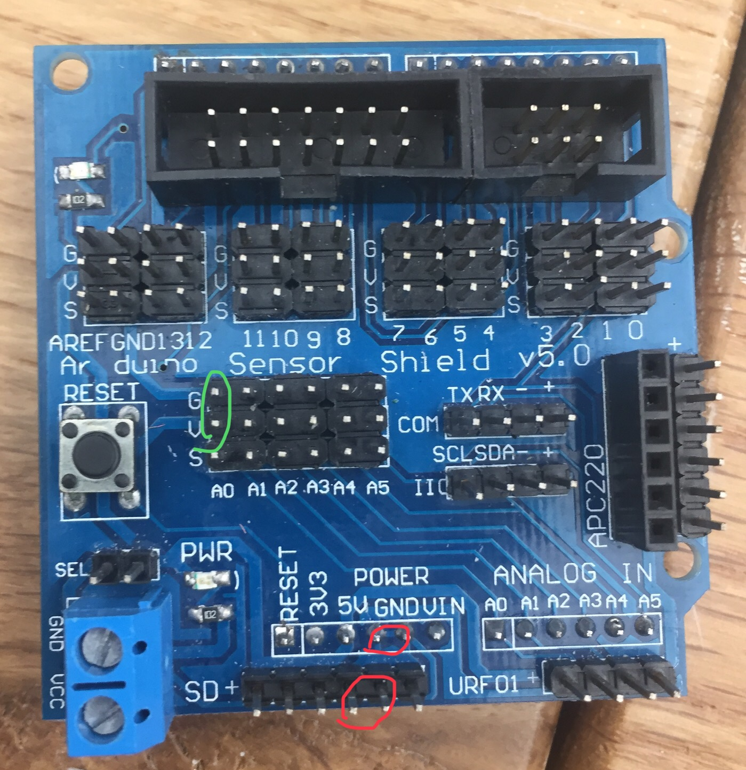
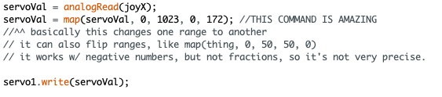
Learning Arduino & Testing the Sensors
When learning how to use the Arduino & Arduino shield, I thought that power went through the red pins, not the green ones, so I was stuck for a while getting a lot of noise.
Later, I followed this video: https://www.youtube.com/watch?v=kA_pbMR6jVs&t=127s to learn how to translate the joystick’s movement to a servo’s movement. Here I learned the map() function.

Slide 3
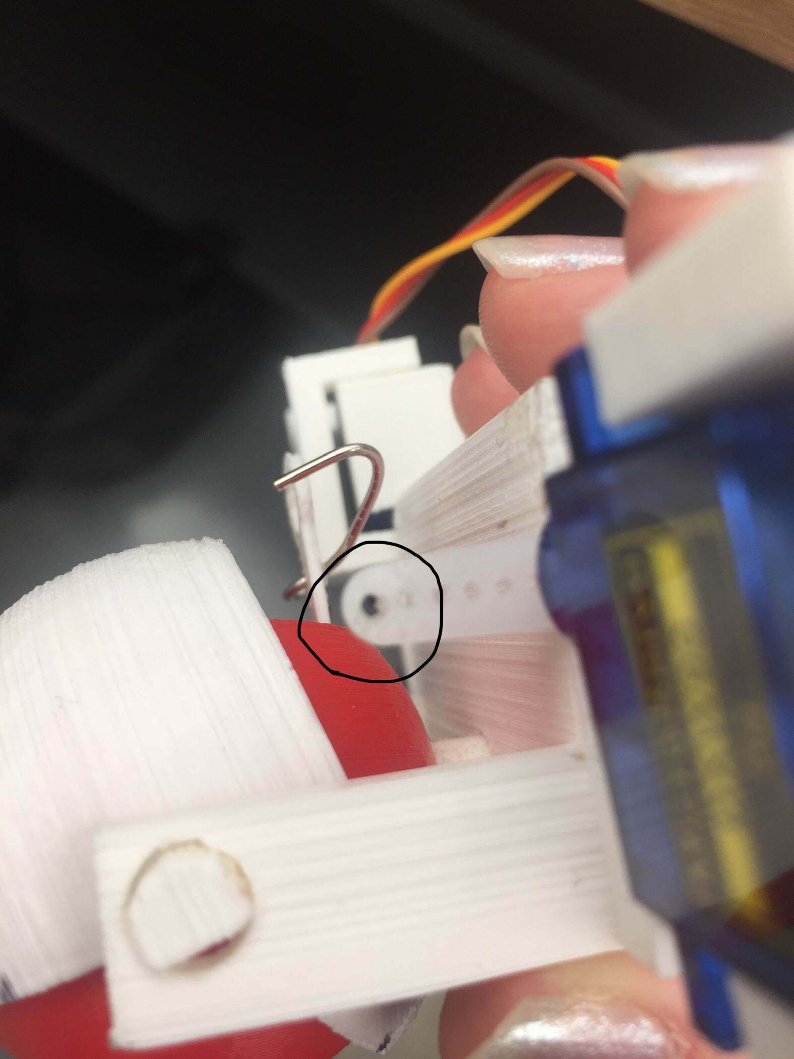
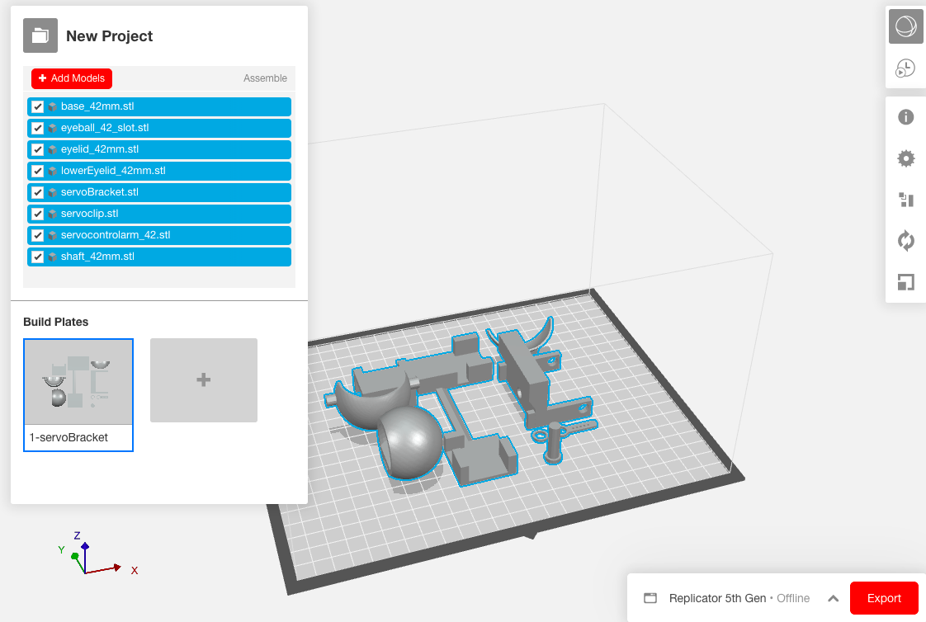
Building the Eyeball:
Following https://youtu.be/jQcxa1lEXb0
I tried using makerbot & the 3D printers, and I drilled the servo’s arms so that a paperclip could fit through it. I also had to use a lot of sanders to smooth down the 3D printed parts.

Slide 4
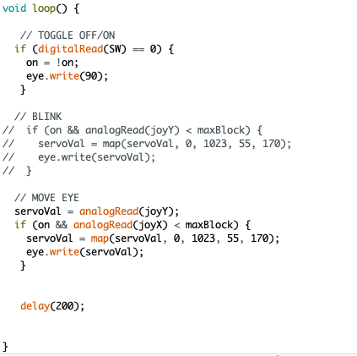
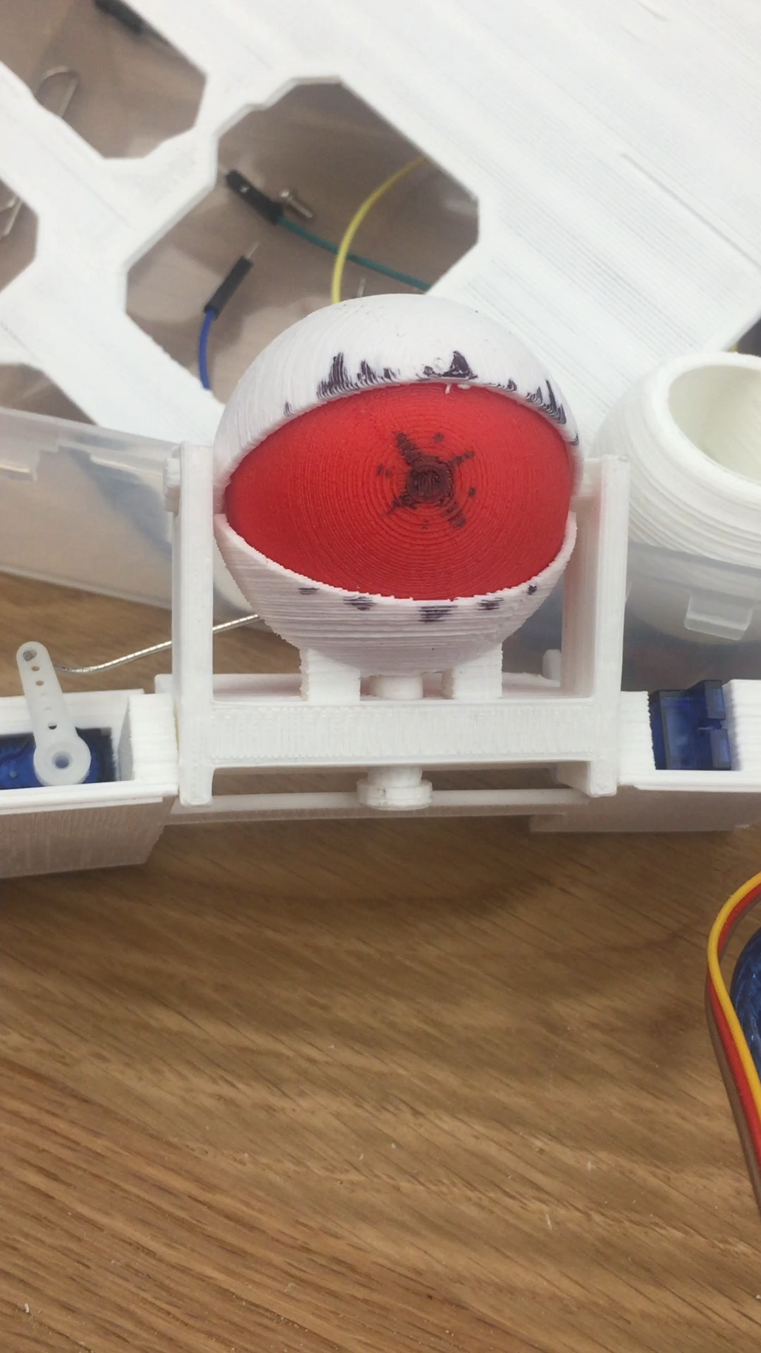
Coding the Eyeball
I added on a way to turn the eye on and off, using the joystick’s switch.
← Preparation for attaching the eyelid’s servo
← Here, instead of following the original project’s code, I ended up continuing to use the map() command again to move the eye.

Slide 5
Moving further: Trying to make the eye appear as if it’s looking towards a person’s face, using the webcam

Slide 6
Processing & Arduino
While looking around for ways to connect the Arduino to my computer’s webcam, I found this project that uses a program called Processing: http://onuravun.blogspot.com/2013/08/using-nokia-5110-screen-as-primitive.html.
I learned how to communicate between Processing and Arduino, using https://learn.sparkfun.com/tutorials/connecting-arduino-to-processing/all.

Slide 7
OpenCV & Arduino
Researching further, I realized that using processing wasn’t actually necessary, I could’ve just connected python to the Arduino and use OpenCV to detect faces that way...
To learn how to communicate between python and Arduino, I followed this tutorial https://www.learnrobotics.org/blog/face-tracking-opencv/ and was able to get python to tell Arduino to make its on-board LED blink.
Then, to I followed a combination of https://create.arduino.cc/projecthub/WolfxPac/face-tracking-using-arduino-b35b6b and https://www.learnrobotics.org/blog/face-tracking-opencv/ to try and connect OpenCV and the Arduino. I also mostly used the code we previously used from https://towardsdatascience.com/face-detection-in-2-minutes-using-opencv-python-90f89d7c0f81 for the face detection part.
First, I simplified the project to make the Arduino’s LED blink when OpenCV detected a face, to make sure data could be sent over. Then, in Arduino, I used the serial monitor to send different numbers to the servo and make it move that amount.

Slide 8
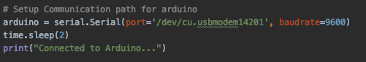
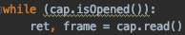
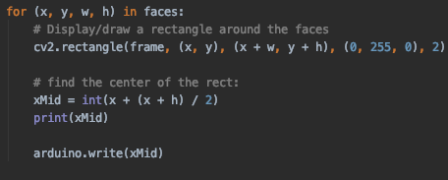
Logic (Python Side)
← connects to the Arduino
← begins capturing a video from the webcam
← It takes a frame from that video
← In that frame, it looks for faces. This function returns a list of rectangles.
← Then, it looks at list of rectangles, finds the horizontal center of each rectangle, (to find the face’s position in the video) and then sends that to the Arduino.

Slide 9
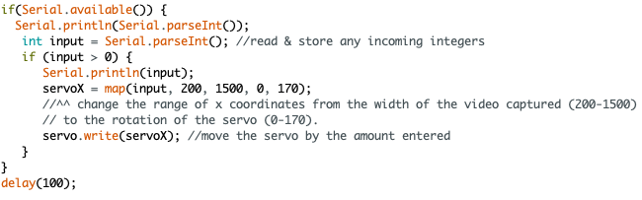
Logic (Arduino Side)
The Arduino moves the servo to a position, based on the face positions that python sent over:

Slide 10
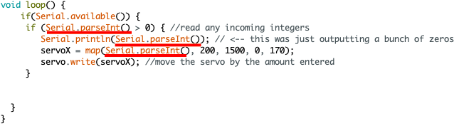
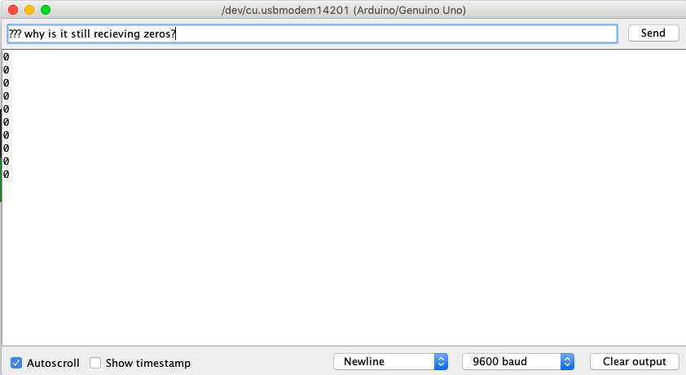
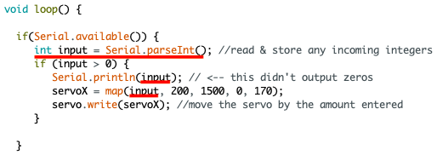
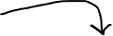
Problems encountered
One big problem I had was that the servo kept resetting its position to zero without the Arduino telling it to, and it wouldn’t move after the first input. I realized that that this was because when nothing was being sent, it was receiving zeroes. And, the data sent was changing too quickly, so by the time it was done checking that the input wasn’t a zero, it received a different input(that’s likely a zero), and uses that one to change the servo’s position. To fix this, I just stored the integer received before testing or using it.
Before:
After:

Slide 11
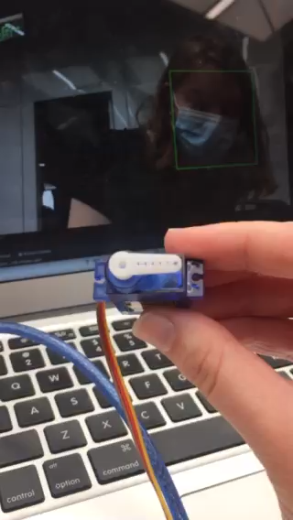
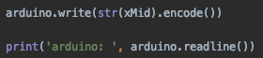
For a long time, OpenCV sending data to the Arduino still didn’t work, since I couldn’t figure out how to send integers over. I learned that I had to turn the position from an integer to a string, then encode it as a byte.
(Found using https://www.instructables.com/Interface-Python-and-Arduino-with-pySerial/, https://www.w3schools.com/python/ref_string_encode.asp, and looking back at the code from https://www.learnrobotics.org/blog/face-tracking-opencv/)
^ To make debugging faster, I also learned about .readline(), which reads anything Arduino prints and helps see if the Arduino was receiving data.
The motor finally goes to the same position as my face! It’s super laggy though…

